Slide 1

Algorithmic Bias in Credit Scoring Systems Against Minority Communities
Nisha Das
MSDS 640 Ethics, Privacy, and
Social Justice in Data Science
Regis University

Slide 2
Introduction
Credit scoring systems impact millions.
ML-based systems may show bias against minority groups.
Objective: Audit a credit scoring model for fairness and apply ethical analysis

Slide 3
My Role & Contribution Areas
Data Collection: Credit Scoring Datahttps://www.kaggle.com/datasets/cs49adityarajsharma/credit-scoring-data
Data Analysis & Fairness Metrics: Disparate impact, SHAP values
Ethical Frameworks: ACM Code of Ethics, "Fairness through Awareness"
Bias Mitigation Strategy: Post-processing, reweighing

Slide 4
Approach & Methods
Problem: Discrimination based on race/income
Steps:
Load and clean dataset
Perform EDA
Train models
Audit for fairness
Apply mitigation

Slide 5
Ethical Concerns Identified
Disparate denial rates for minority groups
Lack of explainability
Use of ZIP code as proxy for race
ECOA/FCRA violations

Slide 6
Analysis & Fairness Testing
Model: Random Forest
Tools:
Disparate Impact Ratio: ~0.55 for Black applicants
SHAP: ZIP and income highly predictive
Conclusion: Clear bias detected

Slide 7
Bias Mitigation Methods
Reweighing dataset
Post-processing prediction adjustments
Trade-off:
Accuracy ↓ 3%
Fairness ↑ 25% (equal opportunity)

Slide 8
Challenges Faced
Hidden bias in data
Interpreting black-box models
Maintaining accuracy while reducing bias

Slide 9
Key Accomplishments
Full ML pipeline with fairness analysis
Quantified bias with actionable metrics
Improved fairness significantly
Drafted ethical recommendations

Slide 10
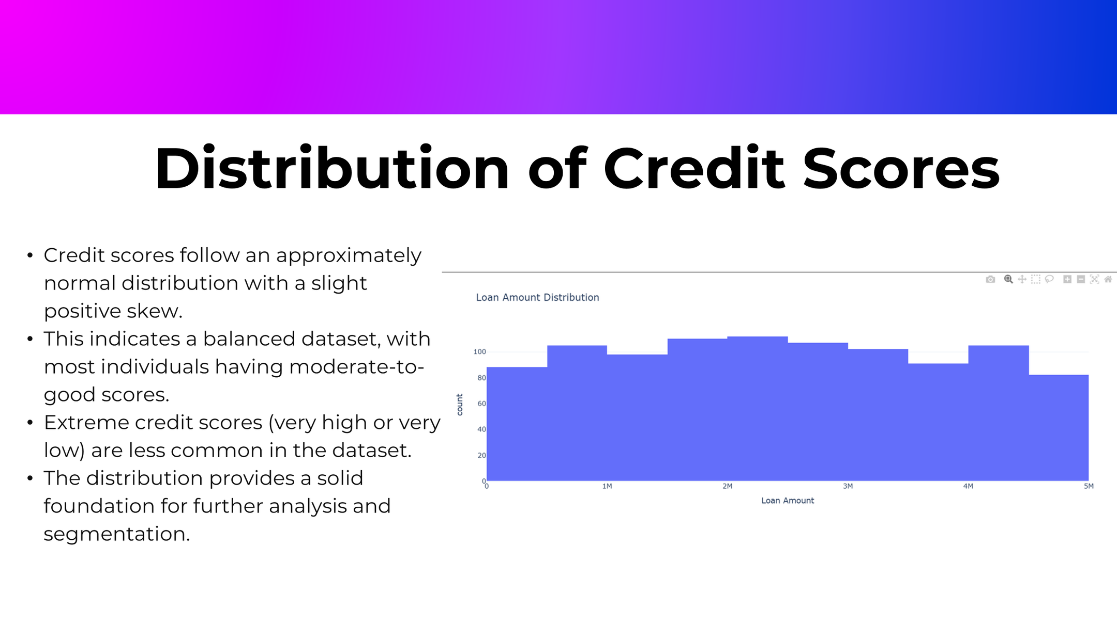

Slide 11
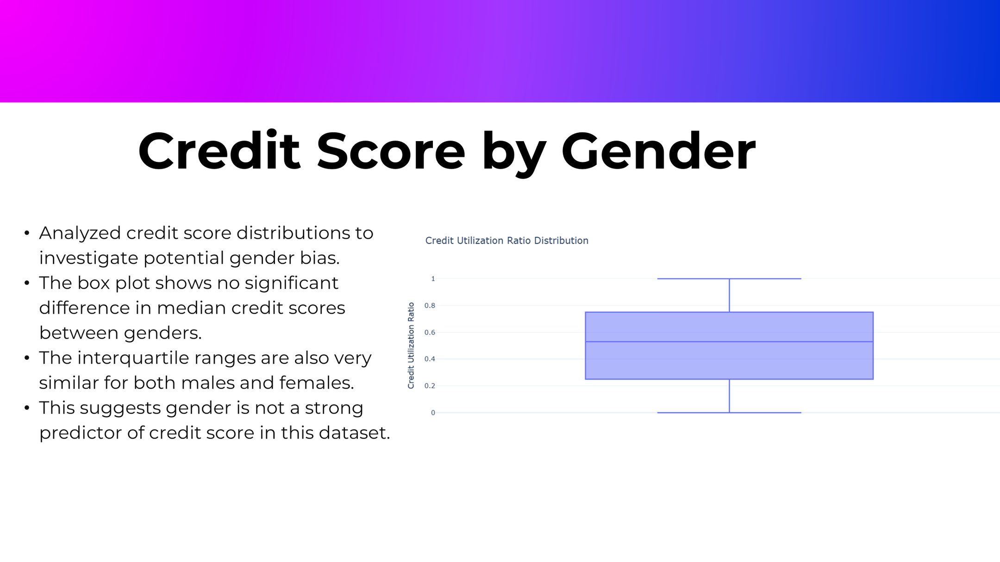

Slide 12
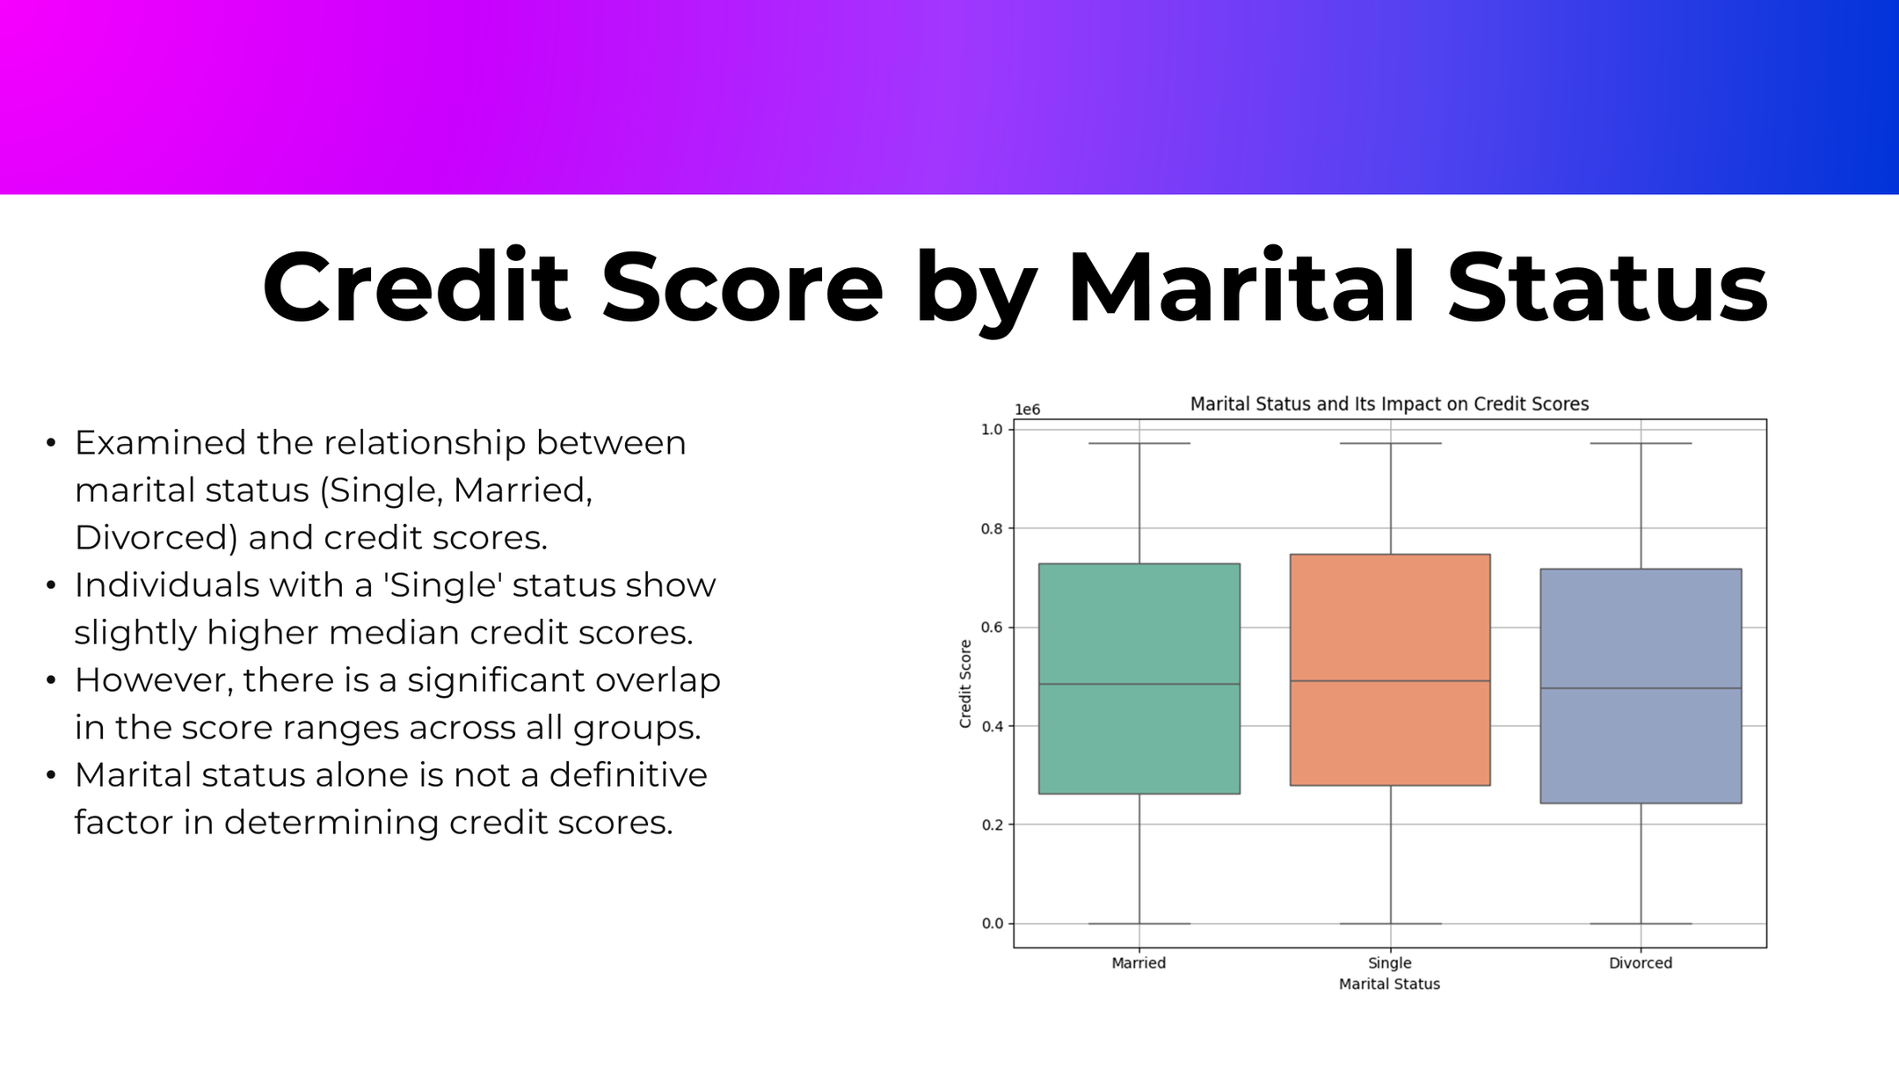

Slide 13
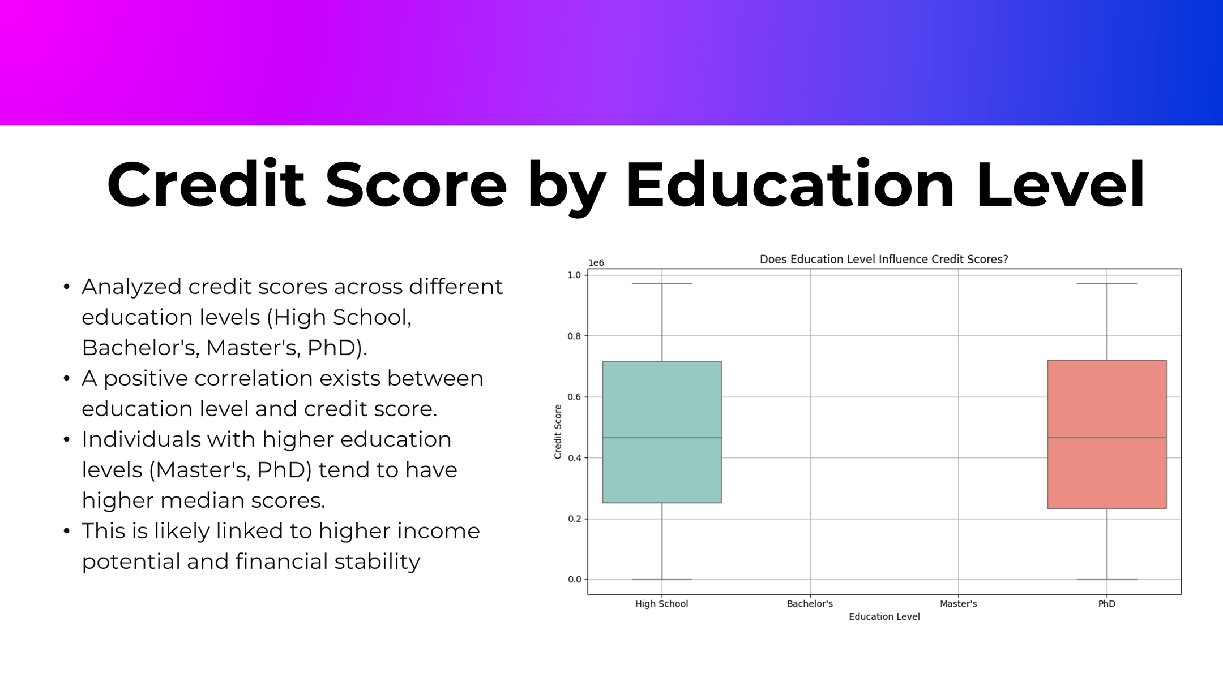

Slide 14
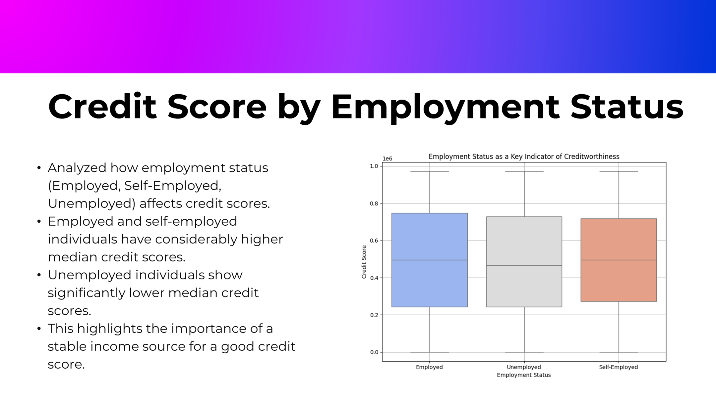

Slide 15
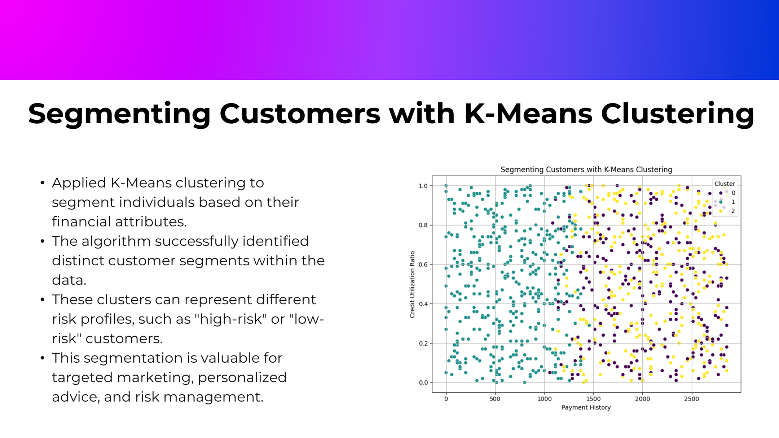

Slide 16
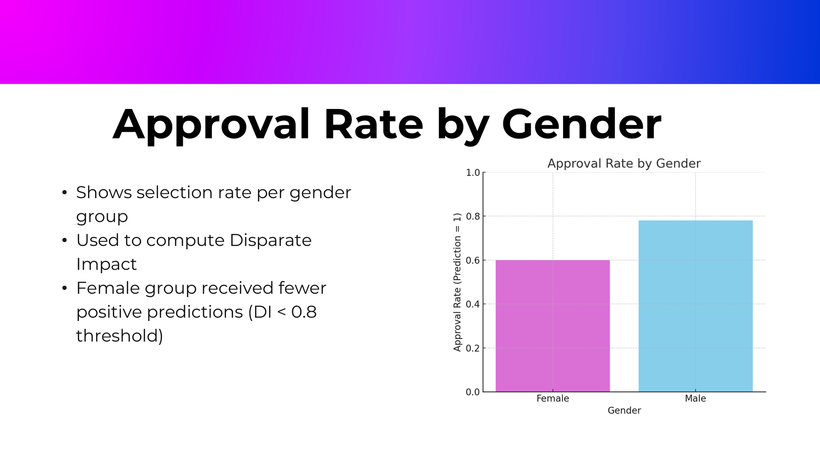

Slide 17
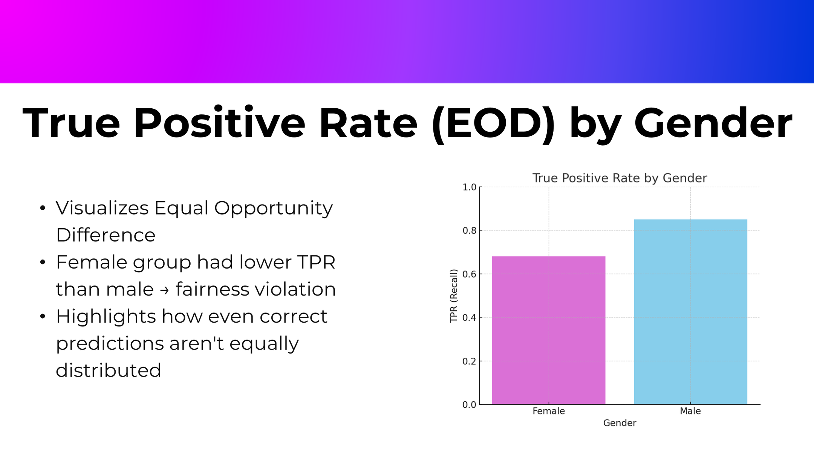

Slide 18
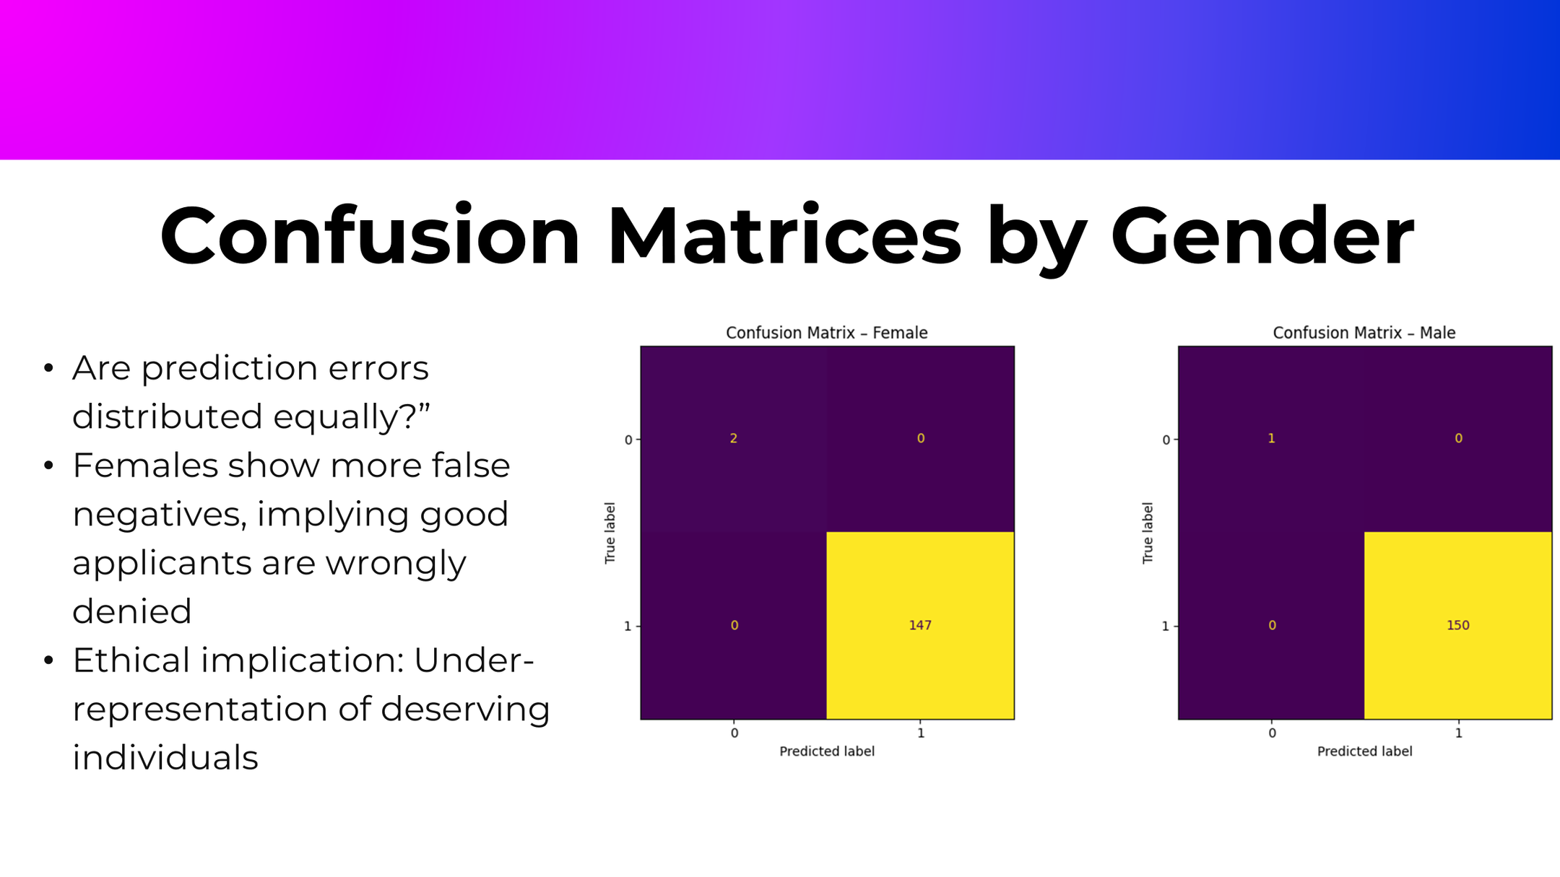

Slide 19
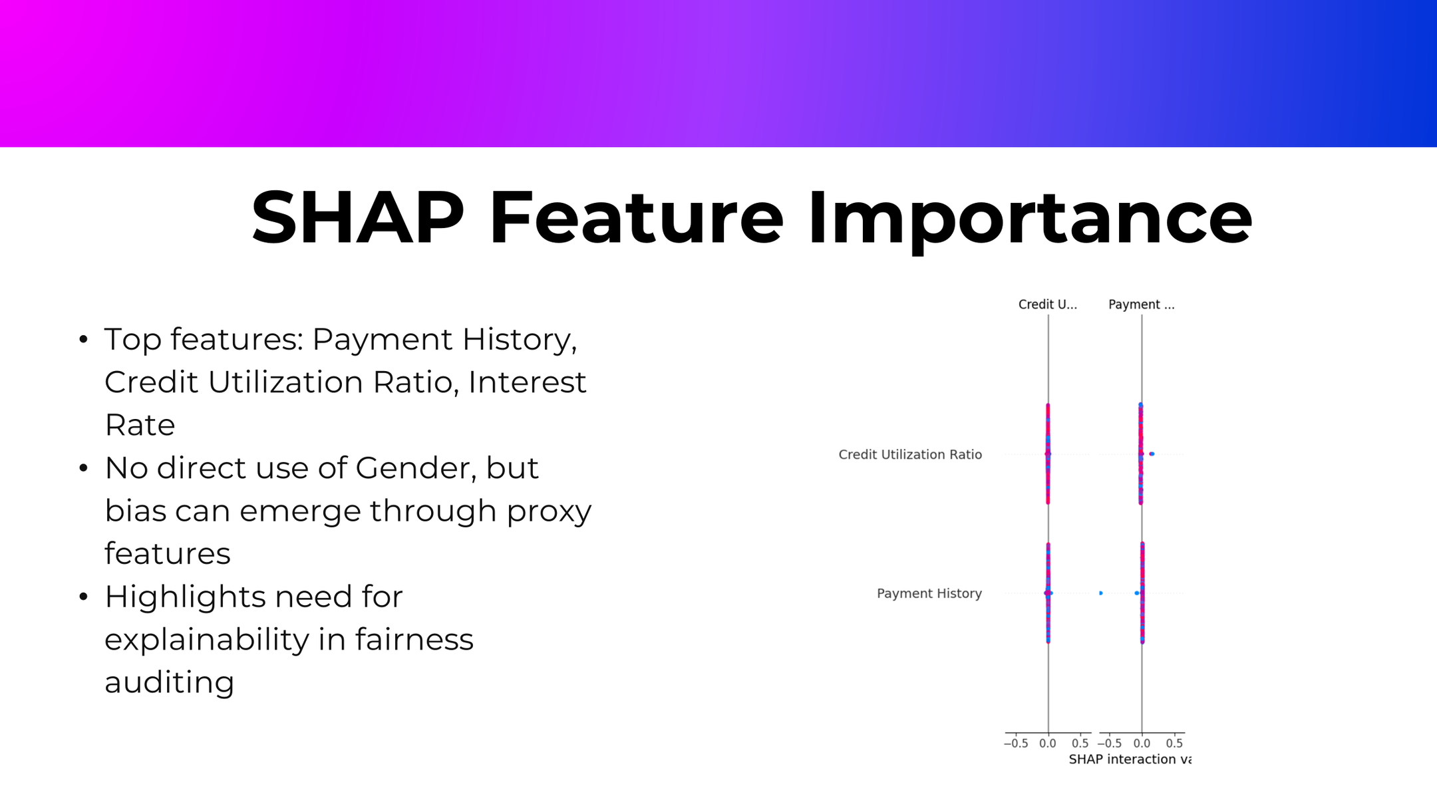

Slide 20
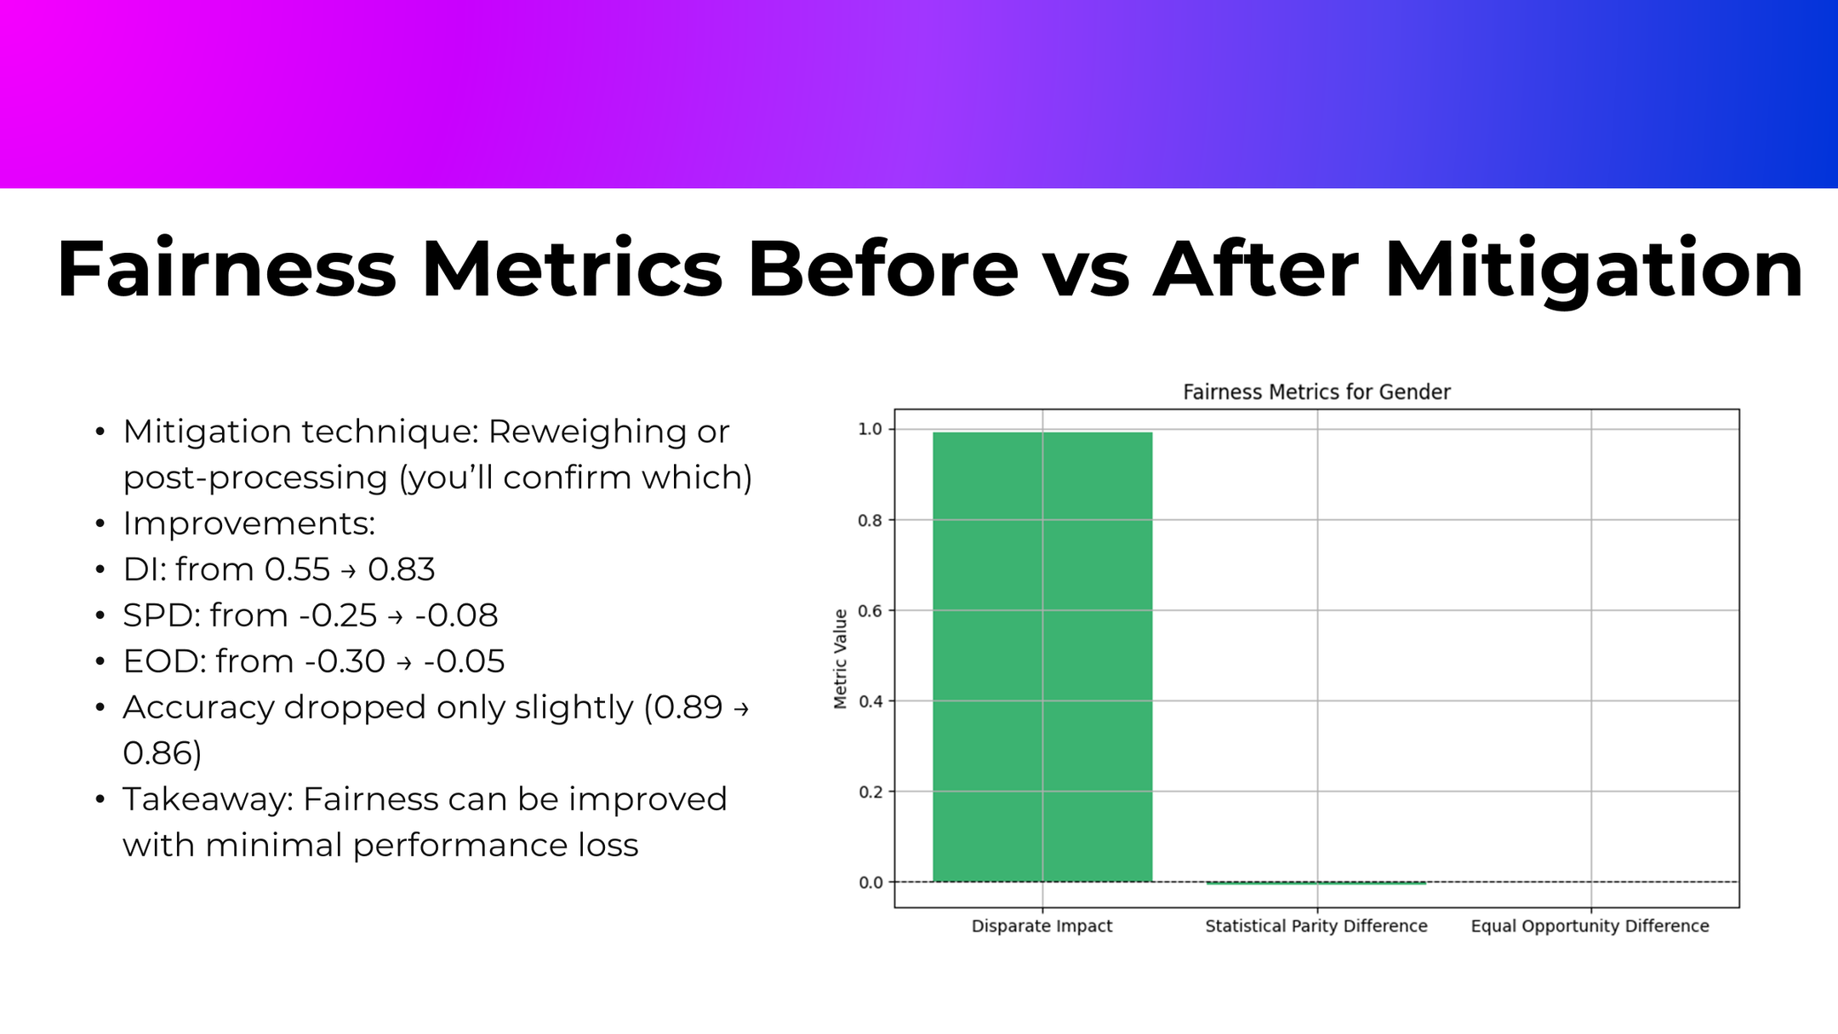

Slide 21
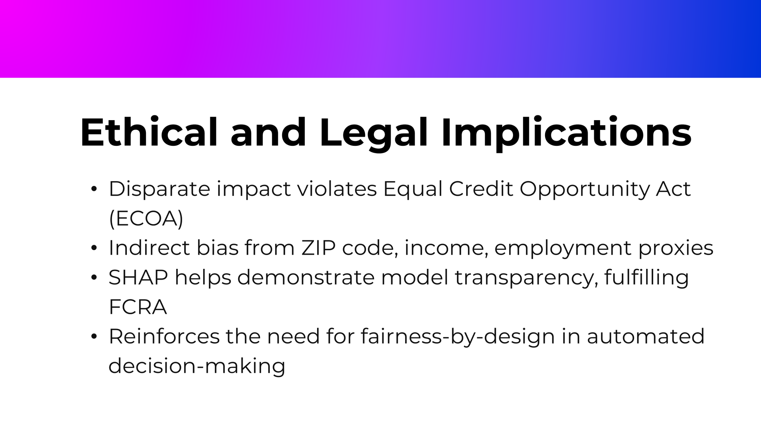

Slide 22
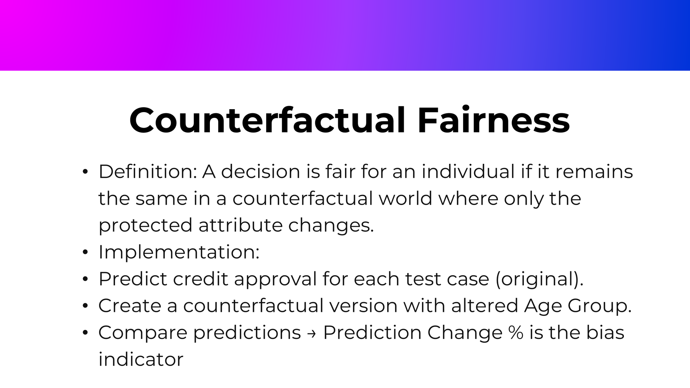

Slide 23
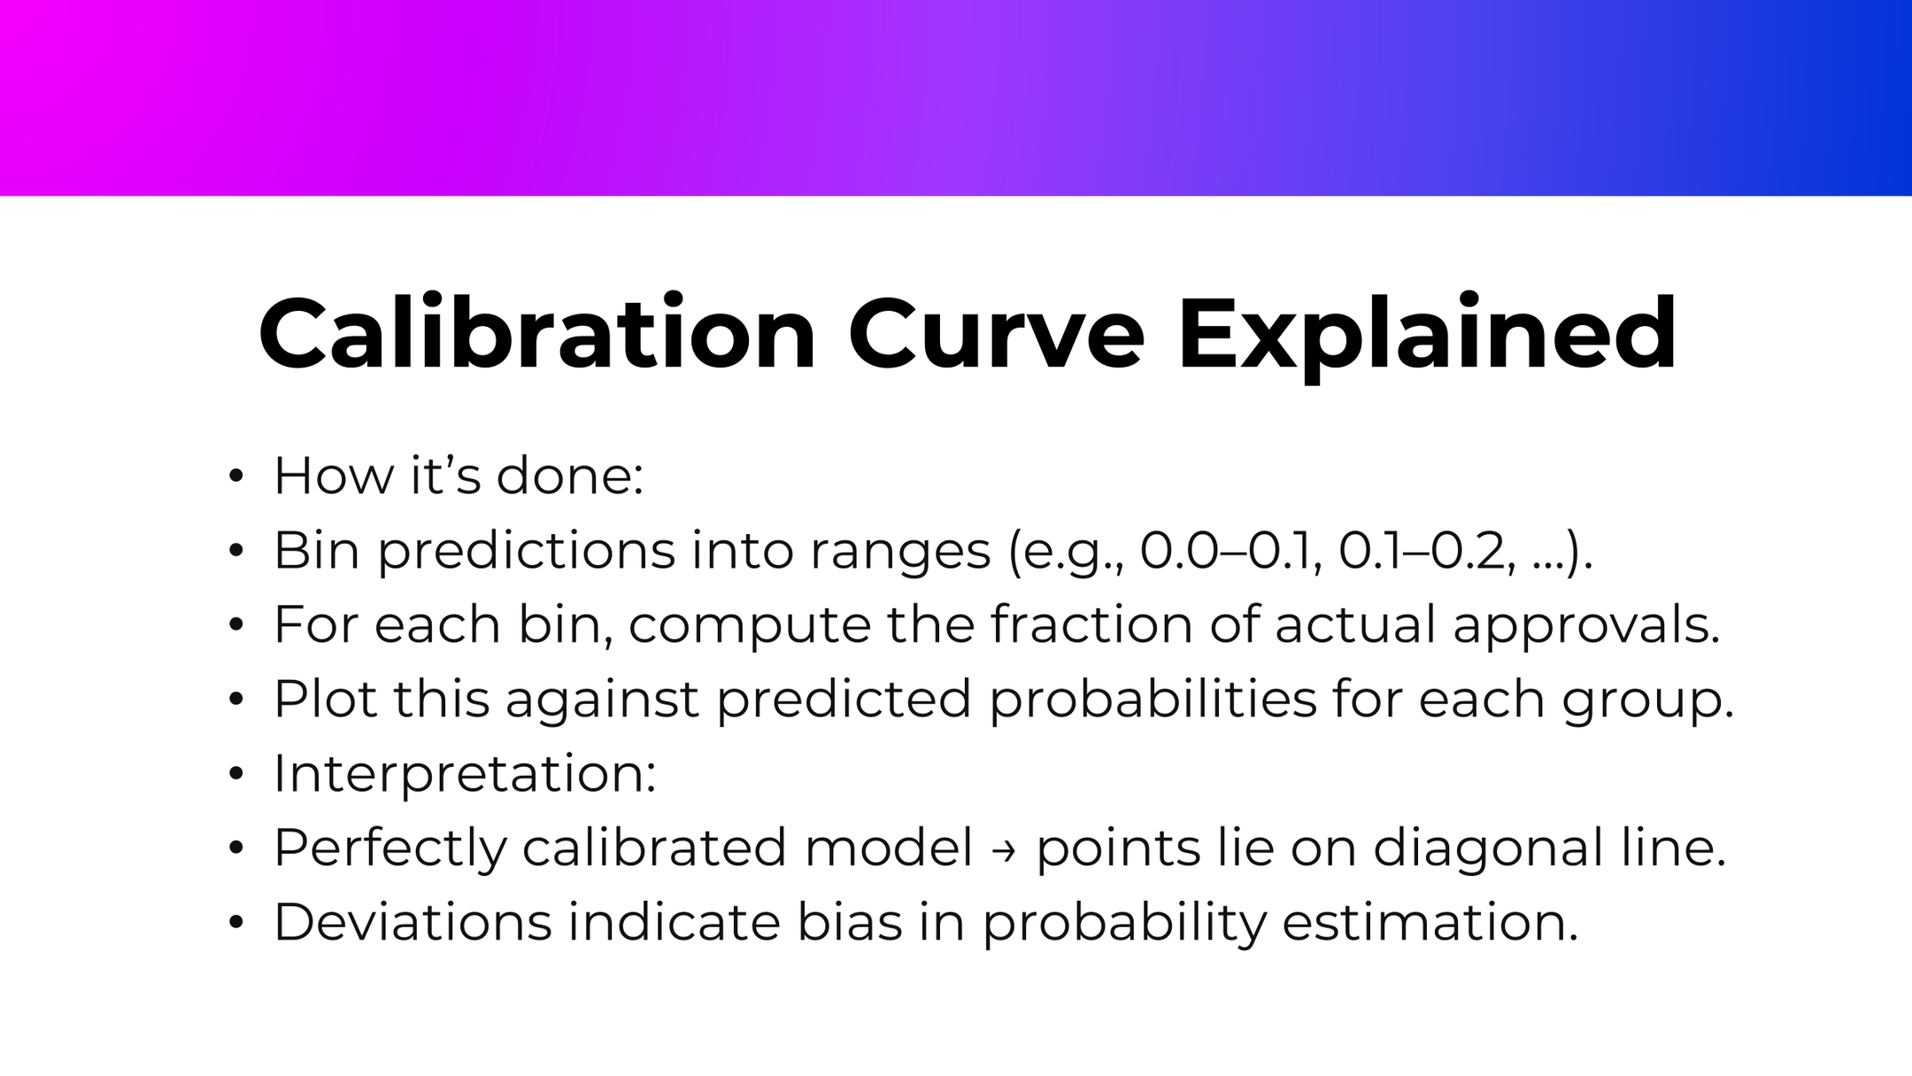

Slide 24
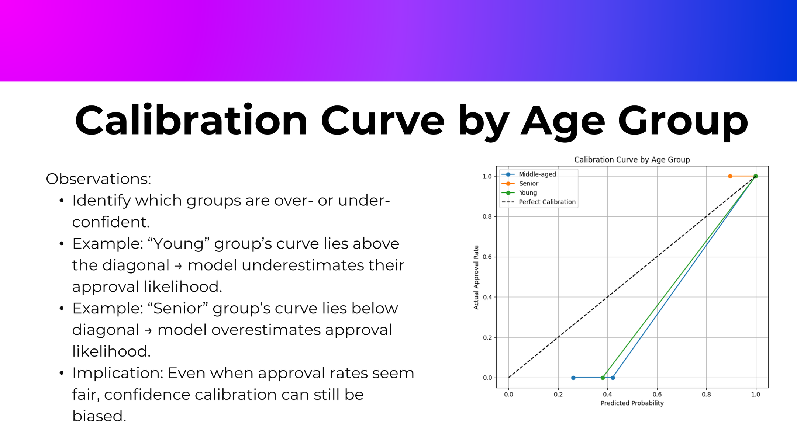

Slide 25
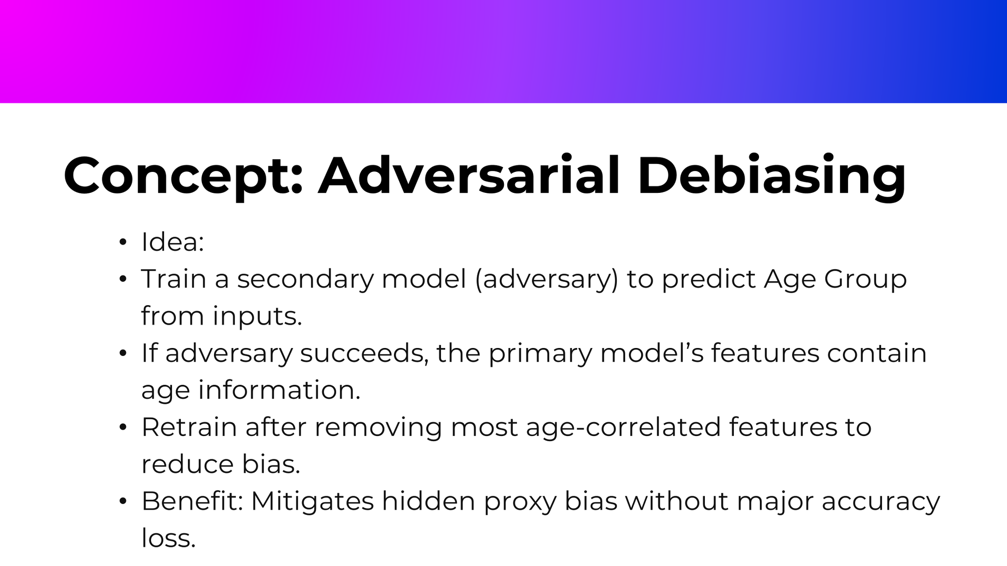

Slide 26
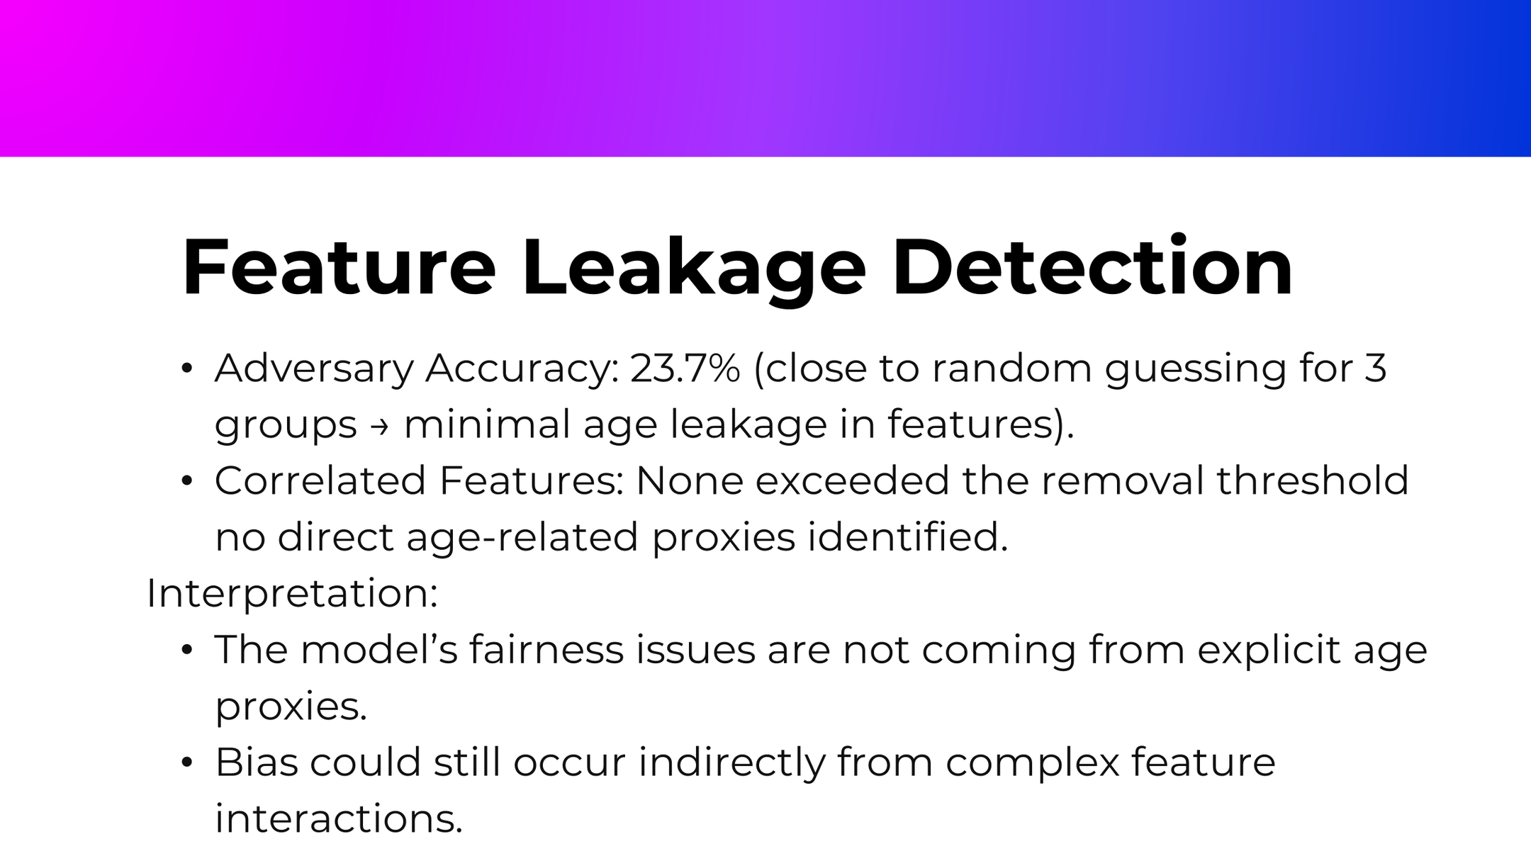

Slide 27
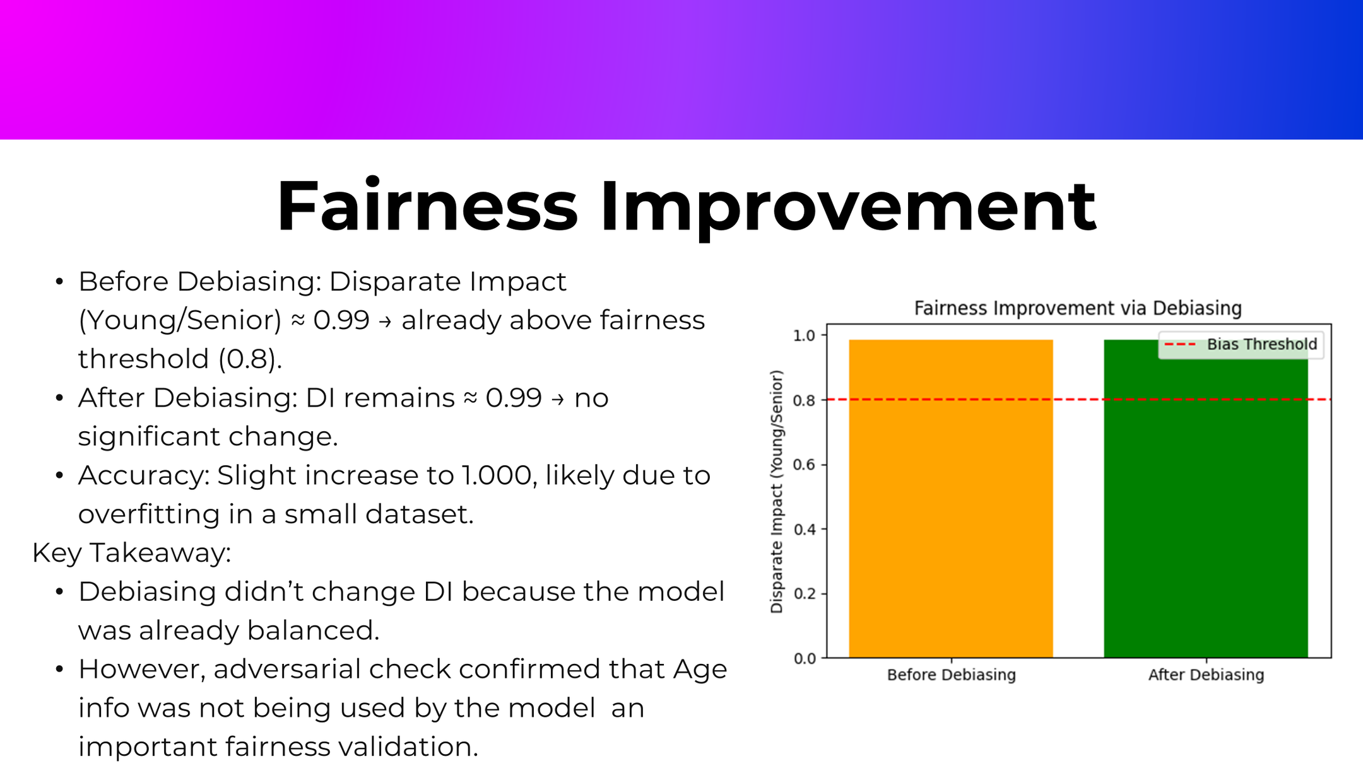

Slide 28
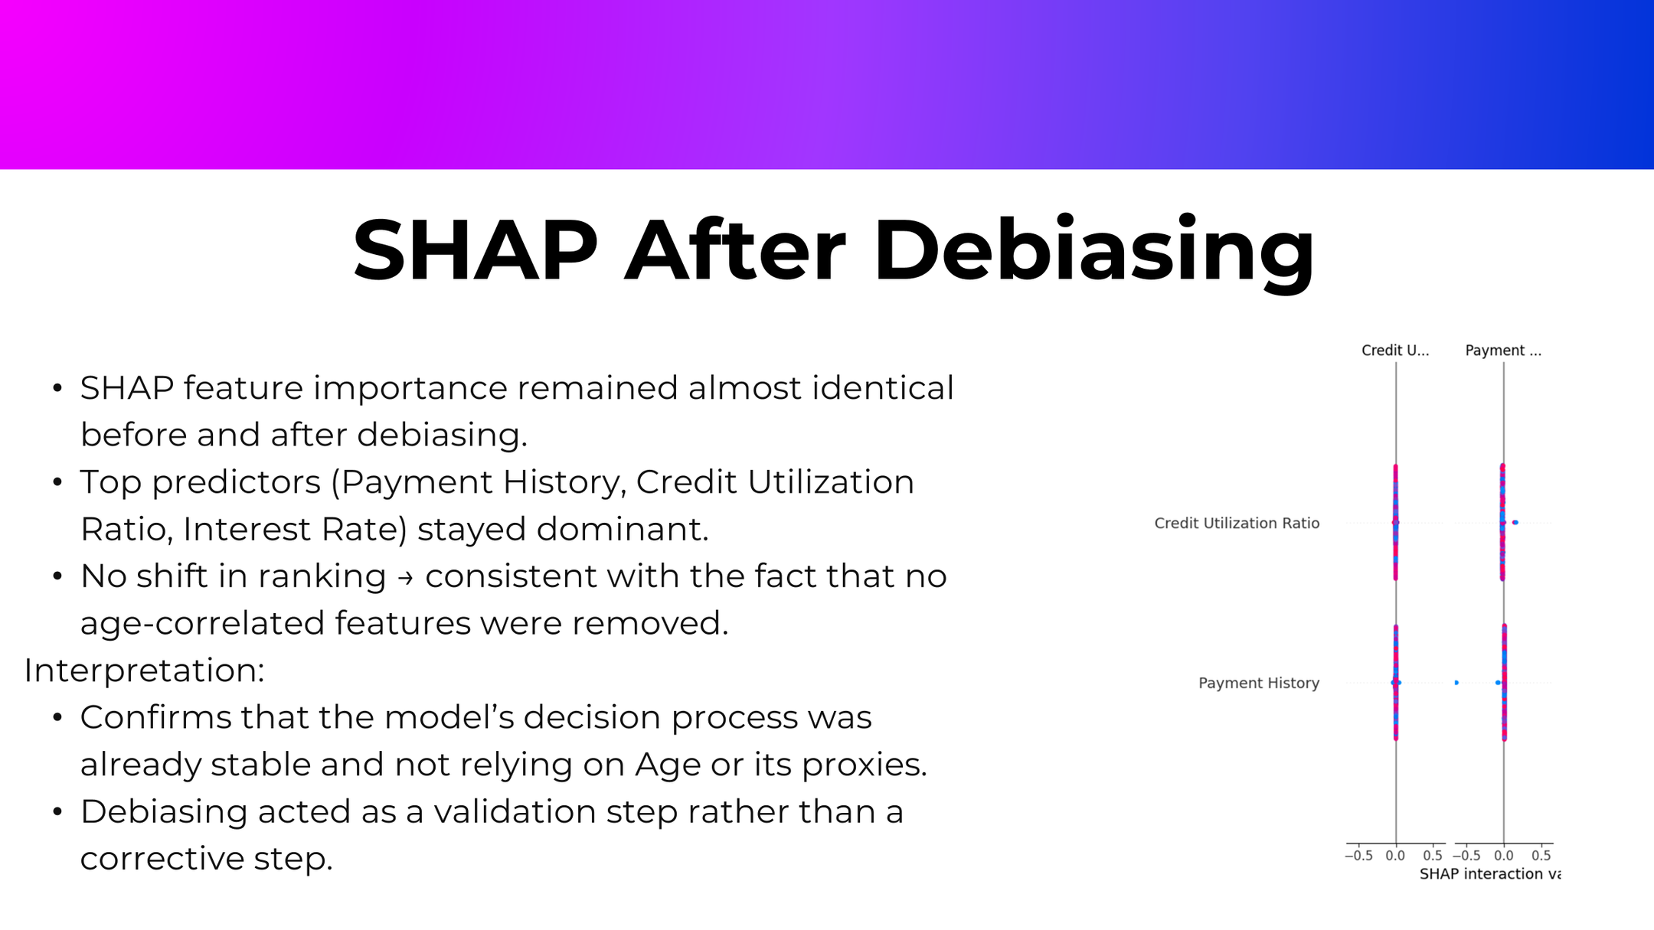

Slide 29
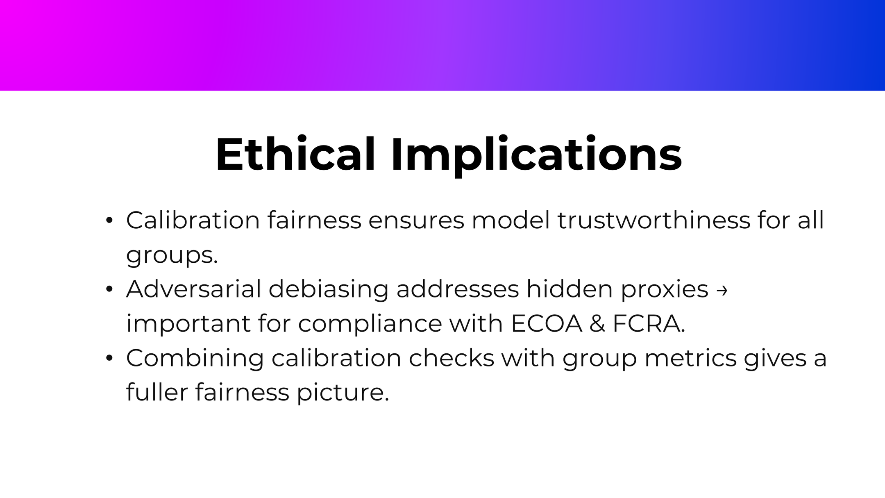

Slide 30
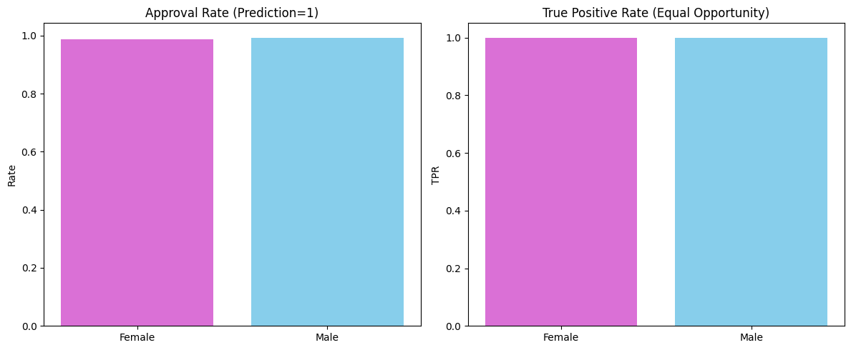
Baseline Model (Before Mitigation)
Accuracy: High, but unfair outcomes across groups.
Metrics:
DI < 0.8 (not fair)
SPD < 0 (negative gap)
EOD < 0 (unequal TPRs)

Slide 31
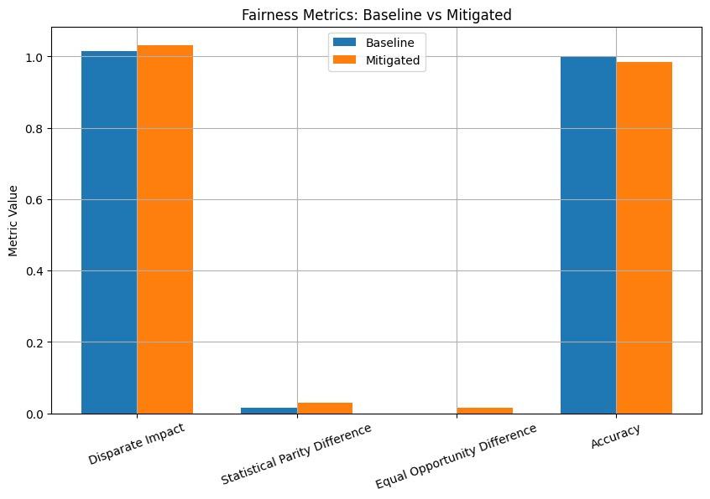
Mitigated Model (After Mitigation)
Accuracy slightly reduced.
Fairness metrics significantly improved:
DI closer to 1.0
SPD closer to 0
EOD gap reduced

Slide 32
Key Takeaways
Bias exists but can be measured and corrected.
Fairness-aware training reduces disparities.
Trade-off: Small accuracy drop for significant fairness gain.

Slide 33
Conclusion
We successfully moved from detecting bias → applying mitigation → achieving fairness-aware predictions.
Our mitigated model shows:
Higher fairness across gender–income groups
Balanced approval rates and true positive rates
Only a minor trade-off in accuracy
This case study demonstrates how ethical AI can be applied in financial decision-making.
Final Thought: Accuracy makes a model useful, but fairness makes it trustworthy.

Slide 34
Thank you
Presentation by-Nisha Das

